Slide 1

SVD compression of results from the Finite Element Method
NLA project, 2019
Vladimir Dmitriev, Veronika Zorina, Alexander Shumilov, Daria Gazizova

Slide 2
Plan
Idea
SVD compression algorithm
FEM
Results and discussion

Slide 3
Idea
Amount of data produced by a complex finite element analysis can be enormous!
Want to save storage capacity and also accelerate the data transfer between computers as the analysis itself and make visualization of the results easier even in the personal computer.

Slide 4
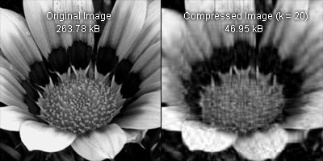
SVD compression
The idea of the SVD compression: taking a high dimensional, highly variable set of data points and reducing it to a lower dimensional space that exposes the substructure of the original data more clearly and orders it from the largest variation to the least.
Fig.1 Usage in image compression

Slide 5
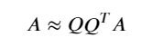
SVD compression algorithm
1) Construct a low-dimensional subspace that captures the action of the matrix. In other words, in this stage we need to compute an approximation basis for the range of input matrix 𝐴:
r vectors of Q could be found from randomize method:
The result of applying 𝐴 to any vector is a vector in the range of 𝐴, and if the matrix is applied to r random vectors, the results will nearly span the range of 𝐴 with extremely high probability

Slide 6
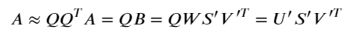
SVD compression algorithm
2) Use 𝑄 to find approximate SVD factorization of A:
Construct 𝐵 = 𝑄^{𝑇}𝐴
Compute an exact SVD of the small matrix: 𝐵=𝑊𝑆′𝑉′^{𝑇}
Set 𝑈′=𝑄𝑊
𝐅𝐨𝐫 𝐚 𝐝𝐞𝐧𝐬𝐞 𝐢𝐧𝐩𝐮𝐭 𝐦𝐚𝐭𝐫𝐢𝐱, 𝐫𝐚𝐧𝐝𝐨𝐦𝐢𝐳𝐞𝐝 𝐒𝐕𝐃 𝐚𝐥𝐠𝐨𝐫𝐢𝐭𝐡𝐦 𝐫𝐞𝐪𝐮𝐢𝐫𝐞𝐬 𝑂(𝑚*𝑛*log(𝑟)) 𝐟𝐥𝐨𝐚𝐭𝐢𝐧𝐠-𝐩𝐨𝐢𝐧𝐭 𝐨𝐩𝐞𝐫𝐚𝐭𝐢𝐨𝐧𝐬, 𝐬𝐮𝐛𝐬𝐭𝐚𝐧𝐭𝐢𝐚𝐥𝐥𝐲 𝐥𝐞𝐬𝐬 𝐭𝐡𝐚𝐧 𝐜𝐥𝐚𝐬𝐬𝐢𝐜𝐚𝐥 𝐚𝐥𝐠𝐨𝐫𝐢𝐭𝐡𝐦𝐬.

Slide 7
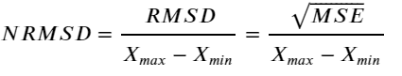
Error estimation
In this work we used 𝐍𝐨𝐫𝐦𝐚𝐥𝐢𝐳𝐞𝐝 𝐑𝐨𝐨𝐭𝐞𝐝 𝐌𝐞𝐚𝐧 𝐒𝐪𝐮𝐚𝐫𝐞 𝐃𝐞𝐯𝐢𝐚𝐭𝐢𝐨𝐧:
Such error metric is able to measure and compare errors in datasets with different scales

Slide 8

Application in finite element method
Since a complex finite element analysis can produce large amount of data, SVD compression algorithm is suggested to help post-process results from finite element solvers. Namely, compress images representing solutions of PDE.
As for solver, we chose FEniCS - open-source computing platform for solving PDEs.

Slide 9

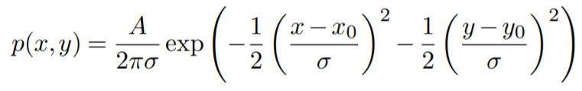
Problem - Poisson equation
We want to compute the deflection D(x,y) of a two-dimensional, circular membrane, subject to a load p over the membrane:
T - tension in the membrane (constant), p - is the external pressure load, boundary conditions – D = 0.
A localized load can be modeled as a Gaussian function:

Slide 10
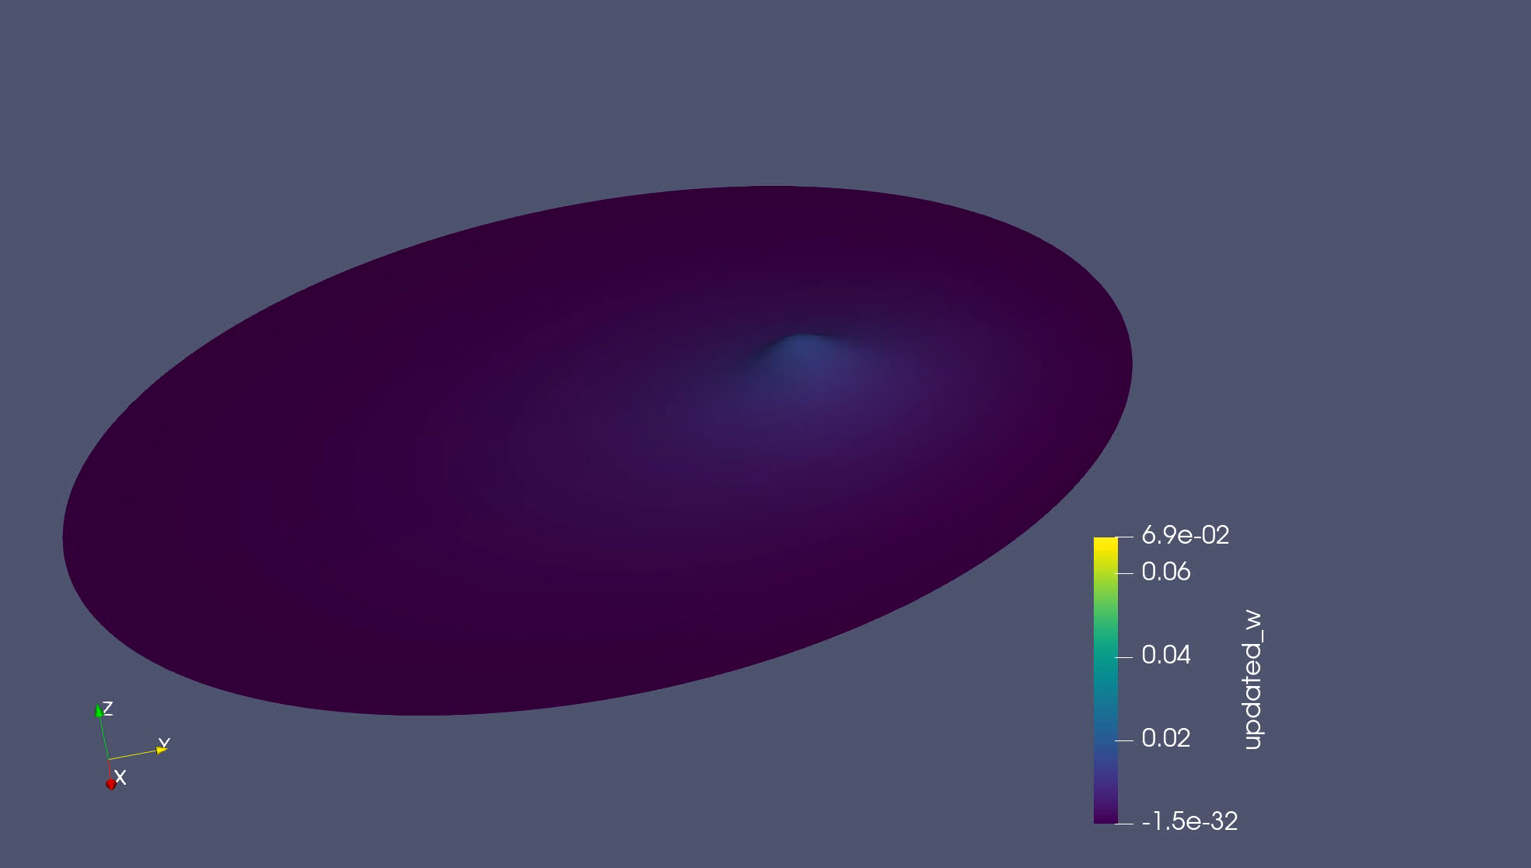
Solutions of PDE*
Fig.3 Solution with increasing load. Optimal rank = 8
* Visualized in Paraview

Slide 11
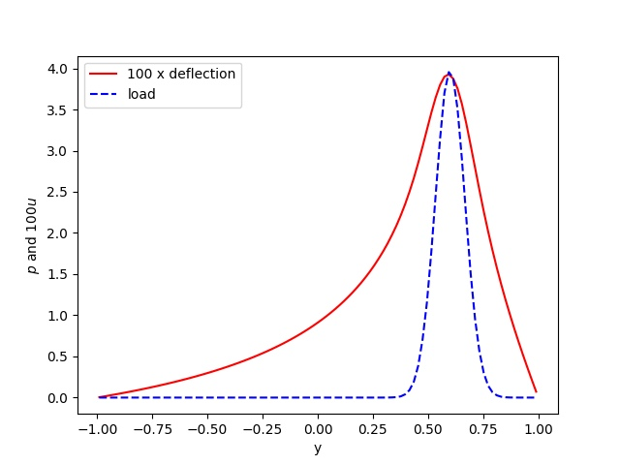
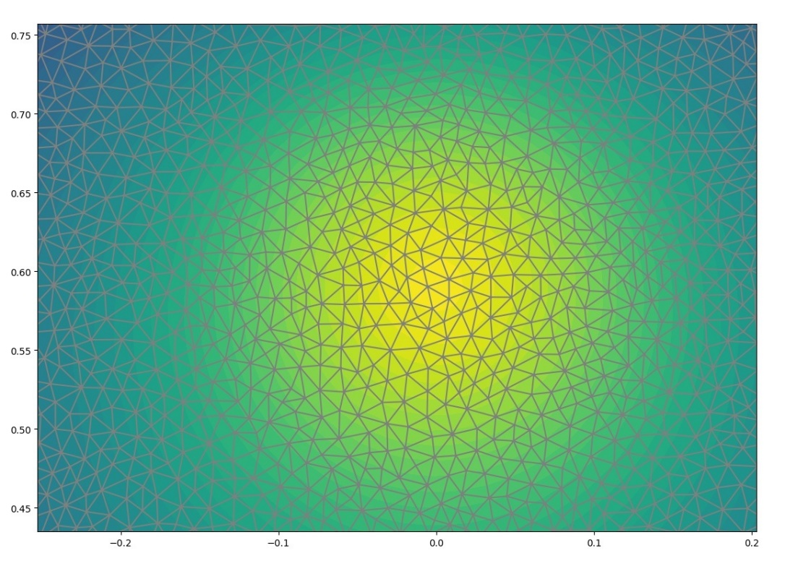
Solution of PDE
Fig.4 Example of mesh for our FEM
Fig.5 Comparison between load and corresponding membrane deflection

Slide 12
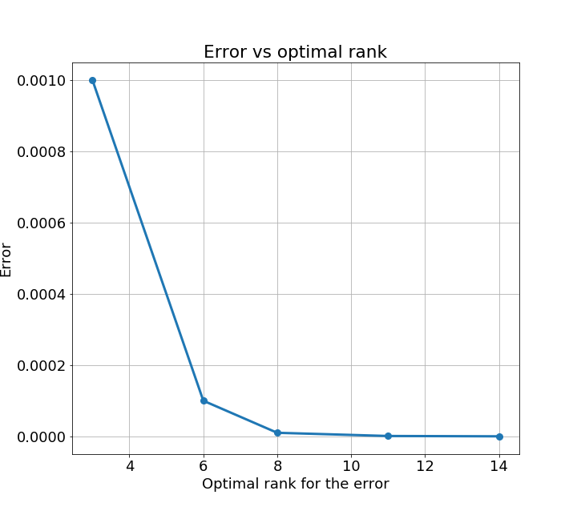
Dependence of NRMSD on optimal rank for results of FEM
Fig.6

Slide 13
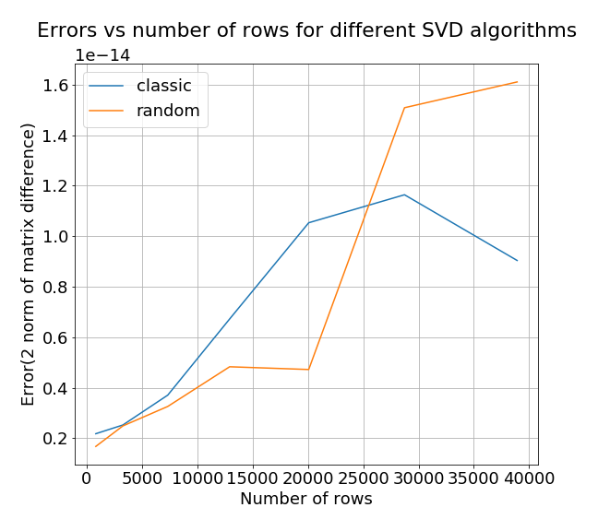
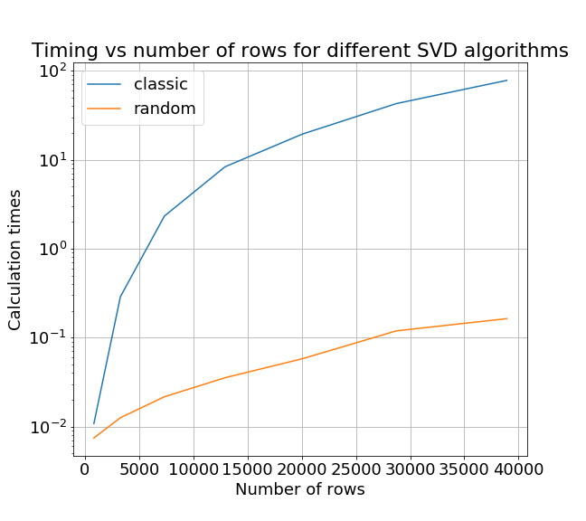
Comparison of standard and randomized SVD
Fig. 7
Fig. 8

Slide 14
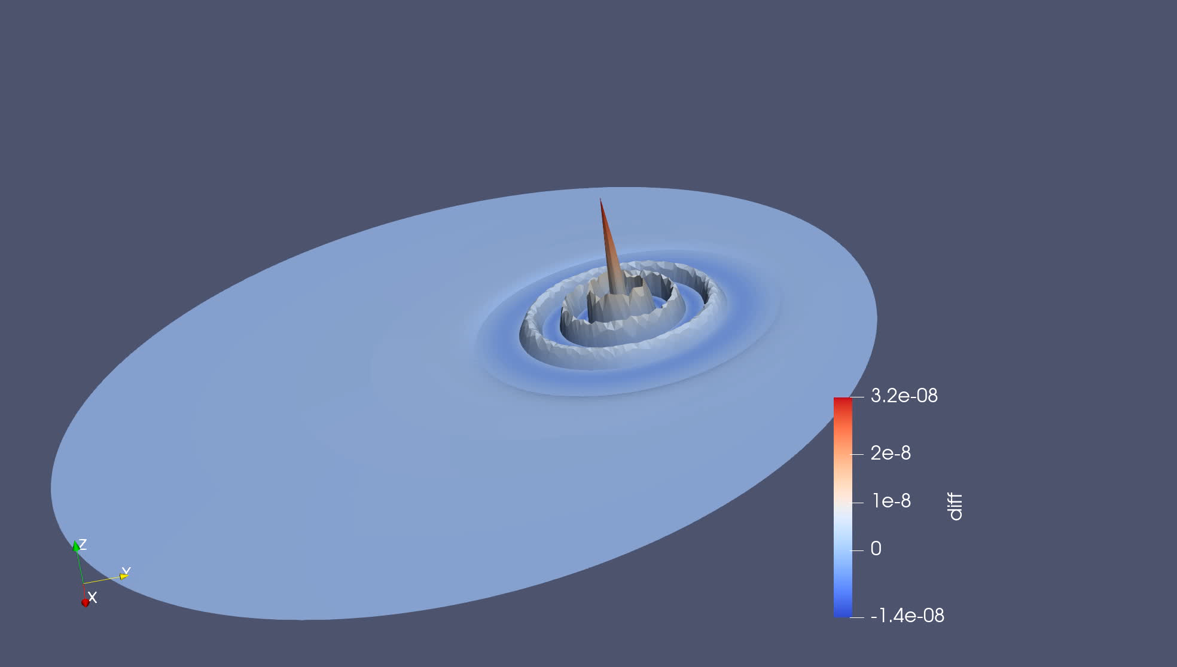
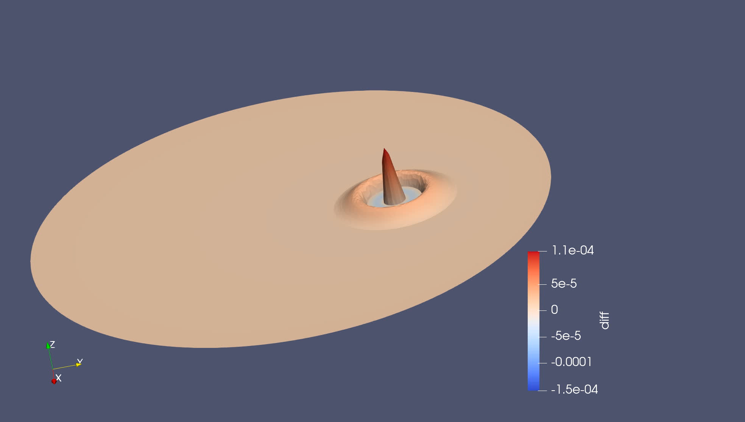
Difference for solution from FEM
Fig.9.1 Difference between original and compressed solution with increasing load. Optimal rank = 8
Fig.9.2 Difference between original and compressed solution with increasing load. Optimal rank = 3

Slide 15
References
Štěpán Beneš, Jaroslav Kruis. Singular Value Decomposition used for compression of results from the Finite Element Method, Advances in Engineering Software 117 (2018) 8–17, 2017. https://doi.org/10.1016/j.advengsoft.2017.12.007
Martinsson P, Rokhlin V, Tygert M. A randomized algorithm for the decomposition of matrices. Appl Comput Harmon Anal 2011;30(1):47–68. https://doi.org/10.1016/j.acha.2010.02.003.
Szlam A, Kluger Y, Tygert M. An implementation of a randomized algorithm for principal component analysis. J ACM (JACM) 2014;1(1).
Halko N, Martinsson P, Tropp J. Finding structure with randomness: probabilistic algorithms for constructing approximate matrix decompositions. SIAM Rev 2011;53(2):217–88
Witten R, Candes E. Randomized algorithms for low-rank matrix factorizations: sharp performance bounds. Algorithmica 2015;72(1):264–81.
Logg, Mardal, Wells. Automated Solution of Differential Equations by the Finite Element Method: The FEniCS Book (Lecture Notes in Computational Science and Engineering), 2012. ISBN-13: 978-3642230981

Slide 16
Thank you for your attention!

Slide 17
Appendix

Slide 18
